Slide 1

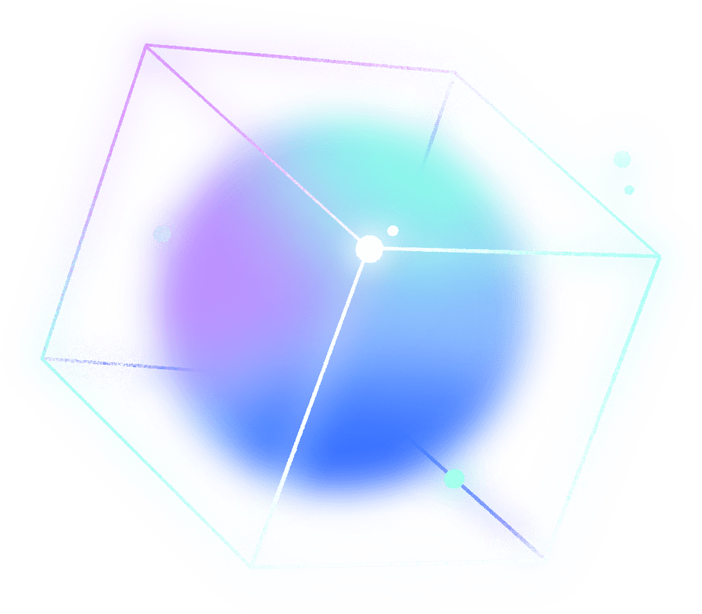



MACHINE LEARNING MODEL DEPLOYMENT WITH IBM CLOUD WATSON STUDIO
Streamlining Model Deployment for Success

Slide 2

MACHINE LEARNING MODEL DEPLOYMENT
Model deployment is the act of putting a trained machine learning model into operational use to make real-time predictions or decisions
It's a critical step, enabling value realization, automation, continuous learning, and competitive advantage
Deployment can be complex due to scalability, version control, infrastructure, monitoring, maintenance, and security concerns.

Slide 3



ARCHITECTURE
Cloud-Based: Hosted on IBM Cloud
Multi-Layered: Comprising UI, Middleware, Data Services, and ML Engine
Scalable: Adaptable for various project sizes
Secure: Prioritizes data security
Integration: Seamless with IBM Cloud and open-source tools
APIs: Allows external integration and customization
.

Slide 4
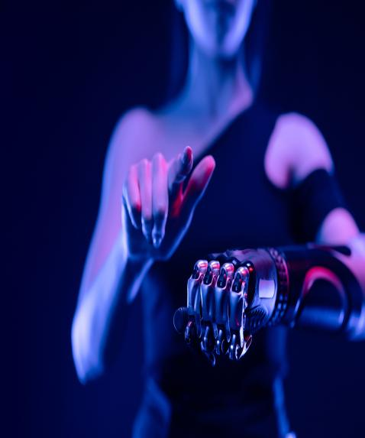

TECH STACK
IBM Cloud Watson Studio: Central platform for model development and deployment
Python: Widely used for machine learning model development
Docker: Containerization for consistent deployment across environments
Kubernetes: Orchestration for managing and scaling containers
Apache Spark: Distributed computing framework for handling large datasets efficiently

Slide 5

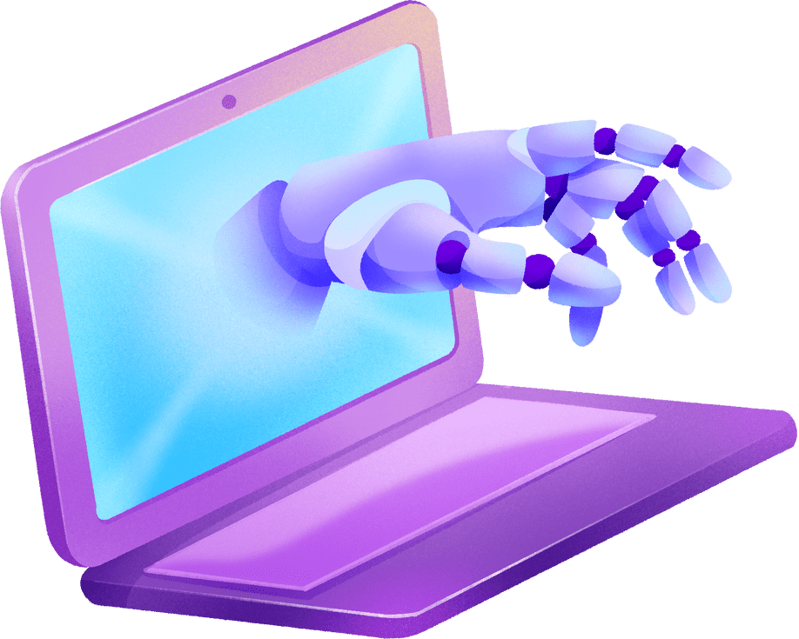
IBM CLOUD WATSON STUDIO
IBM Cloud Watson Studio is an all-in-one platform for streamlined machine learning and AI development
It offers collaborative tools, AutoAI for automated model creation, model monitoring, explainability, and seamless integration with Python and R
Watson Studio boosts efficiency, collaboration, and automation, making it a valuable tool for deploying machine learning models

Slide 6





BENEFITS OF MODEL DEPLOYMENT
Improved Decision-Making: Deployed models enable data-driven decision-making, enhancing accuracy and effectiveness
Increased Automation: Automation of predictions and processes reduces manual effort and improves efficiency
Enhanced Scalability: Models can handle larger datasets and growing workloads, ensuring scalability
Real-time Predictions: Deployed models provide instant, real-time predictions for timely actions and insights.

Slide 7

USE CASES
01
02
03
04
Healthcare
Finance
E-commerce
Manufacturing
Model deployment aids in disease diagnosis, patient monitoring, and predicting health outcomes
It's used for fraud detection, risk assessment, and algorithmic trading
Recommender systems enhance user experience, while demand forecasting optimizes inventory
Predictive maintenance reduces downtime, and quality control ensures product quality

Slide 8



PREDICTIVE MAINTENANCE
Predictive maintenance involves identifying machinery issues before they lead to failures, reducing downtime and maintenance costs
Watson Studio Utilization
01
02
03
IBM Cloud Watson Studio processes sensor data in real-time
It builds machine learning models to predict equipment failures
Alerts are generated for proactive maintenance, optimizing operations

Slide 9

THANK YOU!

